Slide 1


Unity 3D Course
Lection 3.Collisions and Physics

Slide 2
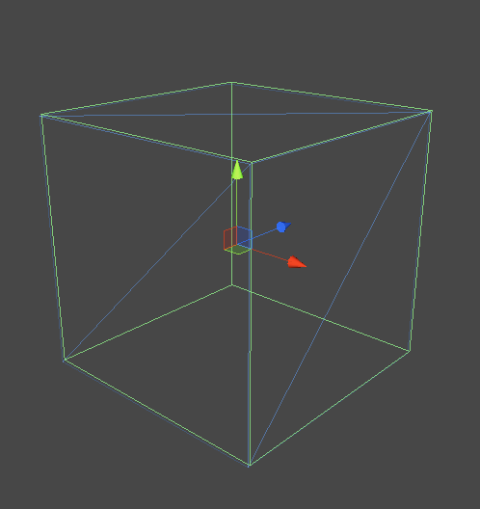
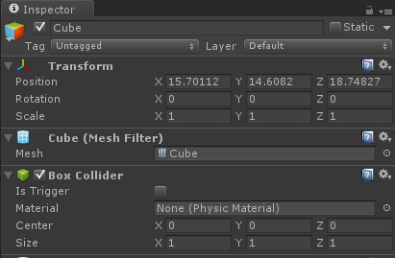
Collisions
Lection 3.Collisions and Physics
Collider Types
Collisions types
Detection types

Slide 3
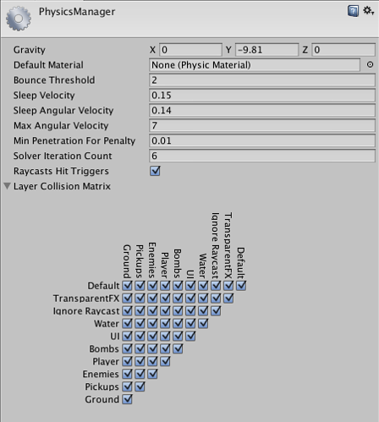
Physics
Lection 3.Collisions and Physics
Physics manager
Physics materials
Raycast
Notes:
http://docs.unity3d.com/Manual/class-PhysicsManager.html
http://docs.unity3d.com/Manual/class-PhysicMaterial.html
http://docs.unity3d.com/ScriptReference/Physics.Raycast.html

Slide 4
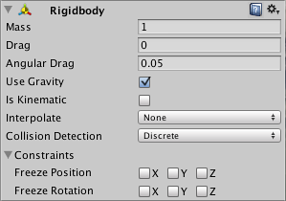
Physics
Lection 3.Collisions and Physics
Rigidbody
Rigidbody scripting
Joints
Fixed
Spring
Hinge
Notes:
http://docs.unity3d.com/Manual/class-Rigidbody.html
http://unity3d.com/learn/tutorials/modules/beginner/physics/joints
Add Rigidbody and access it using scripts. Explain every property etc..
Make one wrecking ball. Check example project Wrecking ball scene

Slide 5
Useful links
Lection 3.Collisions and Physics
http://unity3d.com/learn/tutorials/modules/beginner/physics
http://docs.unity3d.com/Manual/class-PhysicsManager.html
http://docs.unity3d.com/ScriptReference/Collision.html
http://docs.unity3d.com/Manual/class-Rigidbody.html
http://unity3d.com/learn/tutorials/modules/beginner/physics/joints
http://unity3d.com/learn/tutorials/modules/beginner/physics/joints

